Slide 1
Regulatory
Regulatory Intelligence
René Hardee
Regulatory Affairs Manager, Hologic
Interview by Darwin Shurig
CEO/Founder, Shurig Solutions Inc.
2022
Do you have a challenge currently with a strategic initiative relevant to RA, Quality, Engineering, Clinical, Operations or Sales/Marketing talent?
Let’s schedule a Needs Analysis Conversation!
Please feel free to schedule directly on our calendar.
6814 S CR 100W, Clayton, IN 46118
info@shurigsolutions.com 317-983-4473

Slide 2
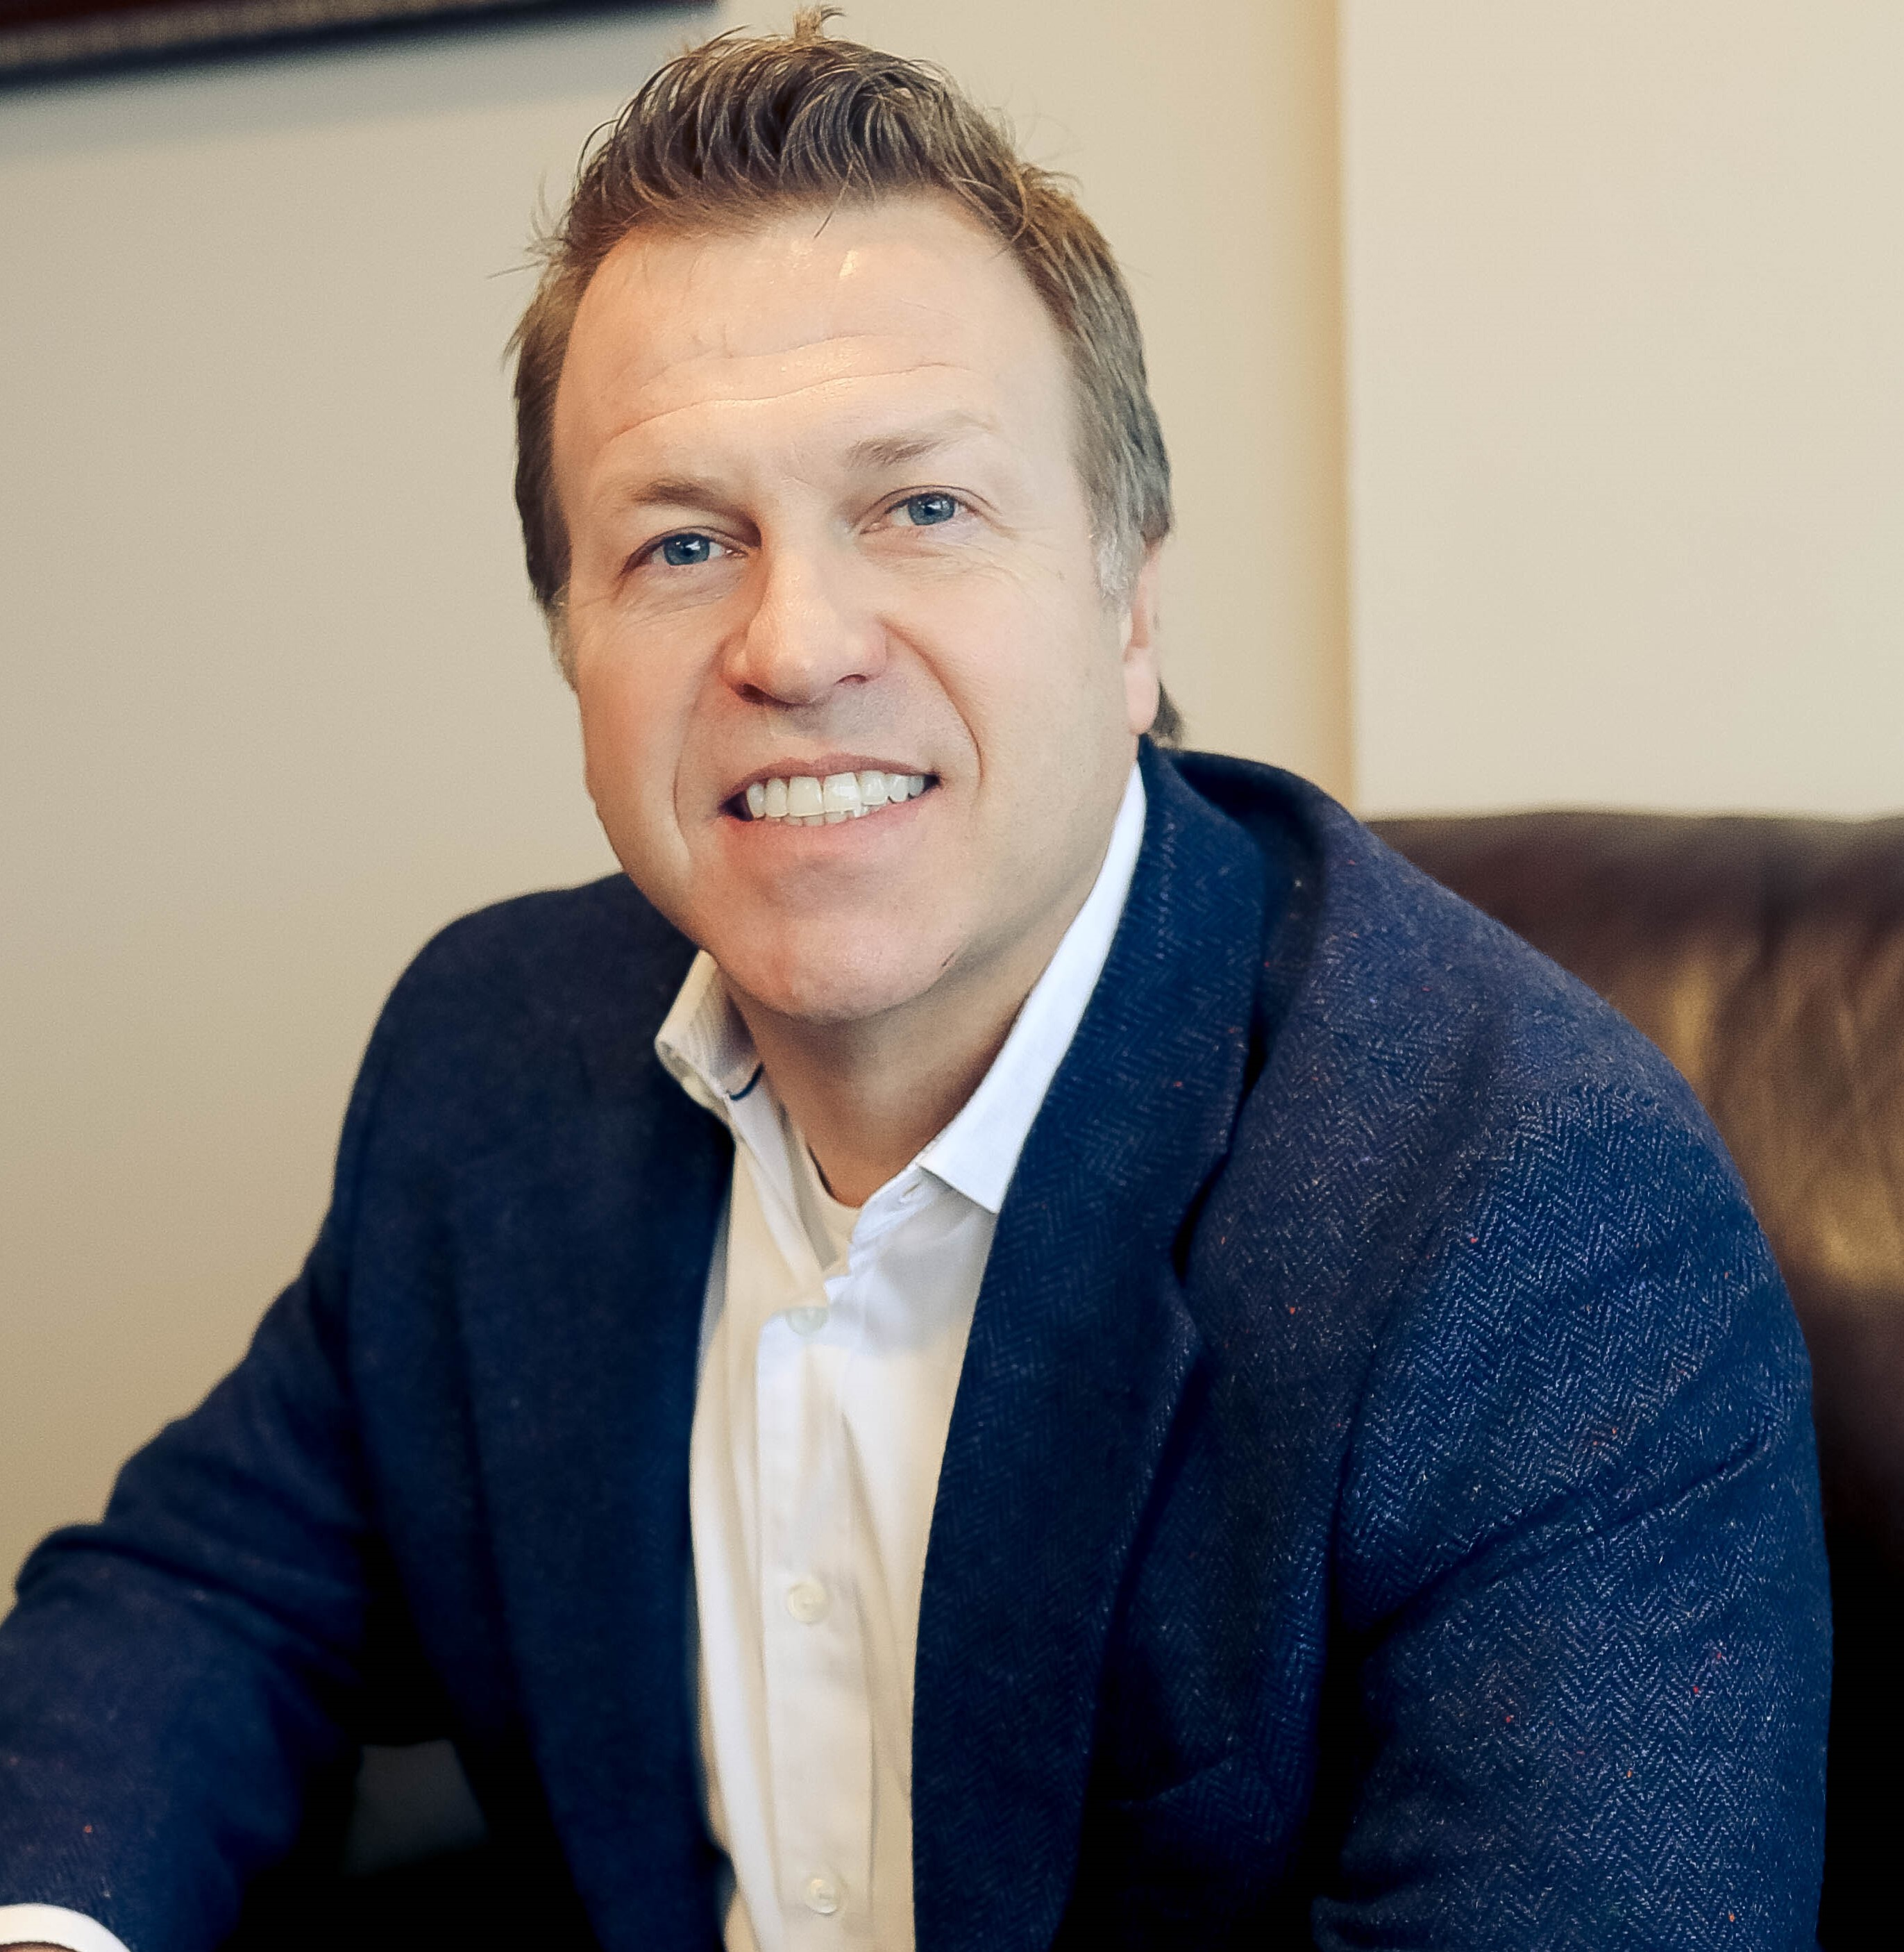
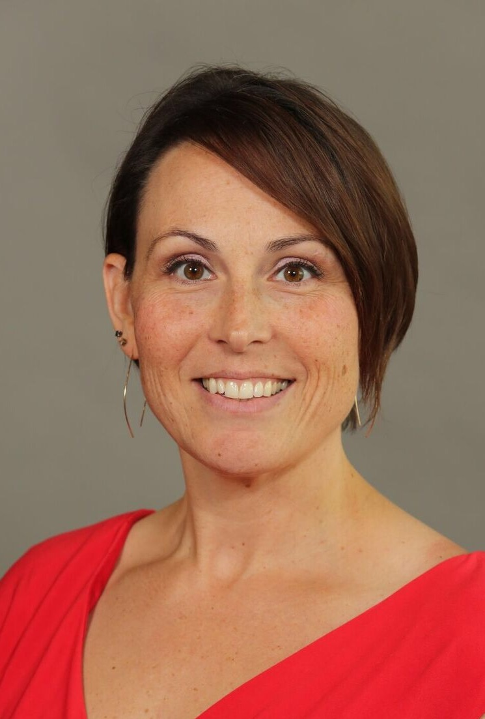
DARWIN SHURIG
PRESIDENT - SHURIG SOLUTIONS INC.
Darwin Shurig understands the key qualities that companies look for in candidates to grow market share, while enhancing their positive culture and team environment. He has a clinical background of over 20 years, including 15 years of sales experience within:
medical device, diagnostics, medical distribution, and sleep therapy; 8 years in sales management success; 3 years in operations; and extensive experience in negotiations and business development.
SSI has been growing for over 6 years with a focus on RA, Quality and Engineering within the Medical Device and Pharma industries. With over $3 Million in revenue and a 91% offer acceptance rate, SSI is helping companies find unique talent that makes a difference, brings value, and decreases the risk of a mis-hire.
René Hardee
RA MANAGER - HOLOGIC
Rene’ Hardee is a Regulatory Affairs Manager with Hologic, Inc. and is currently helping build Hologic’s global Regulatory Policy and Intelligence Program.
Previously, Rene’ spent her days launching rockets at Kennedy Space Center, but shifted discipline to the Medical Device industry 13 years ago to pursue a career aiding radiation oncology. Rene’ has held roles in the Medical Device field ranging from R&D, Quality, and Regulatory Affairs. Rene’ holds a Masters Degree in Astrophysics from Vanderbilt University and is passionate about helping Hologic tackle Women’s Health Care across the globe.
Link to Full Webinar

Slide 3
What is Regulatory Intelligence
René: Regulatory Intelligence is keeping up with all the changes that would impact your products or your industry or your jurisdictions that you market your product. We know that those things change all the time, all the regulations, all the requirements they're constantly changing and how are you keeping up with those. It's keeping up with that fire hose of information changes that are coming at you every day.
Then, how do you use that strategically? You must have a regulatory strategy of how you're keeping up with all these changes and then you can use it to influence policy and requirements.
(Continue to video links)
Video Link
Regulatory
The Growth of Regulatory Intelligence
Darwin: I’ve been hearing more and more about Regulatory Intelligence over the past couple of years. Tell me about how you transitioned into that role.
René: It was 2015 when I first heard the term Regulatory Intelligence and I was very excited about the sound of it and thought it was right up my alley. I was doing submissions at the time and was fine doing them, but to see all the new things and be on top of what’s going on, what’s happening, what’s new today, and being the first person to read about it, analyze it and send it to the people whom the information impacts, that’s what I enjoy doing.
(Continue to video links)
Video Link
Moving into Regulatory Intelligence
Darwin: You were in Radiation Oncology, Medtech doing submissions, then you moved to Regulatory Intelligence, tell us how that move happened.
René: When I started looking for a new position, I was looking for something in Regulatory Intelligence and this position opened up at Hologic in Massachusetts and a tiny part of my position was to try to start a Regulatory Intelligence Program at Hologic. So, that is what drew me in because it was something I wanted to do and this position allowed me to “plant the seed” and turn it into an entire department. I started 3 1/2 years ago with a small RI department, and it’s grown into a department of its own.
(Continue to video links)
Video Link

Slide 4
Interesting Career Path
Intelligence
Darwin: Your career path is very unique and intriguing, so tell us how you went from Aerospace to Medtech.
René: I have a Master’s Degree in Physics and I worked at the Space Center for several years, however in 2008 the economy took a dive and I was laid off. With no prospects of getting another Aerospace job, a friend told me about a Medical Device company in a small town that was hiring Physicists. I called up one of their physicists and took them out to lunch to pick their brains on what is medical physics. After lunch I went to the HR department and asked if they were hiring, I got an interview and worked there for 10 years.
(Continue to video links)
Video
Define Regulatory Intelligence
Darwin: Give a little more detail of what Regulatory Intelligence looks like in terms of compliance versus policy.
René: So, perhaps you don’t have either the bandwidth, the resources, the money to totally put a Regulatory Intelligence department that covers both compliance and policy, then maybe start with the compliance part. Focus on keeping the doors open, products on the market, and being a little more proactive in response to a lot of regulation changes instead of waiting until an auditor finds something wrong and you have to either do a recall or more testing.
Darwin: This puts you in a reactionary mode to an emergency.
René: Exactly and that emergency will cost you money. You will pay for it either way, you can be proactive and have your resources preventing those emergencies or you will pay for it on the back end and potentially even lose more money.
(Continue to video links)
Video Link
Regulatory Intelligence – Policy side
René: On the policy side, more mature companies feel they have the compliance side under control now they want to move into how to get even more in front of these changes and influence or help write the laws and regulations that are changing. How can we be involved in that, how can we have an opinion, how can we be a part of all that and get the total upfront knowledge instead of waiting for the information to be sent out. Being involved in these meetings and helping write the laws and regulations is to your advantage. Giving your opinions and trying to influence them and getting that upfront knowledge.
Darwin: Proactive versus reactive and the opportunity costs are significant.
(Continue to video links)
Video Link

Slide 5
Sources
Sources of Information
Darwin: As you look at the FDA or even DC from a policy standpoint, what are some of those responsibilities in your position?
René: I do a lot of reading and over time I’ve been able to figure out what are the best sites and news feeds to get this information from. Of course, the FDA has a lot of different newsletters but also free subscription services with newsletters as well. One that we use a lot with radiology is Aunt Minnie, they put out daily newsletters that I read through to see if there might be anything that Hologic cares about. These are not newsletters on changes in regulations, but what are other things happening out there with AI and Radiology that maybe our engineers might want to know about.
When you implement a RI department in your company you get to define the scope, you get to say what kinds of things do we want these people looking at. Is it only regulations, guidance documents, or standards? At Hologic, we have a larger scope with full-time people dedicated to doing this research which includes competitive intel, what type of tech is out there, and then we send it to the people we feel could use that information.
(Continue to video link)
Video Link
Sharing Regulatory Intelligence
Darwin: As you gather intelligence and identify a particular topic, changing regulation or something in the industry that you think could be unique or beneficial, how are you disseminating that information out to stakeholders at Hologic?
René: We have a written process where the information resides. If there’s a new technology, competitor information, issues with the supply chain or operations, we do triage and basically, send to the different contacts within Hologic. We have an internal program run by our communications department where we can post information and people can subscribe to our channel. We also have direct email that goes to certain teams and that would be our second level of urgency or importance. The third level is a weekly meeting with a regulatory representative from each of our divisions.
Part of my daily job is creating a log of all the things that are more actionable and who needs to look at them and then we review them once a week with the team to make sure that everybody is aware of what’s happening and if there is an action that has to happen and how can we coordinate and duplicate our efforts if we have to analyze that.
So, consistent message and not duplicating resources but utilizing our resources efficiently and creating a central hub of information.
(Continue to video links)
Video Link

Slide 6
Regulatory Intelligence and Governing Bodies
Priority
Darwin: Talk about the FDA and some of the other responsibilities you have.
René: So more of the influence side, Hologic sits on a lot of trade organizations which is a great way to try and gain influence. What’s great about trade organizations is you can have a lot of different people coming together to give feedback on something such as a guidance document that the FDA says draft for comment. A company can respond directly, but that usually has to go through legal or you can go through a trade organization where you give your feedback, and they lump it in with other feedback and respond to the FDA as an advocate. Many times, that will hold more weight than one company’s feedback especially if it’s a small company.
It’s a matter of how to maintain control and keep up with the feed coming in, a trade organization wants to know this on a released guidance document or standard and what does Hologic has to say about it. What’s the process and how do we comment on our stance, who’s the expert that needs to see this so they can provide their comments. (Continue to video links)
Video Link
Hologic Pivots to Help Out
Darwin: Tell me how Hologic proactively reached out to partner with the FDA and to benefit people relevant to the pandemic.
René: Hologic is a women’s healthcare company, we traditionally have made IVDs for testing for STDs and things like that. When we saw Covid-19 was coming that was a real opportunity for us to utilize these relations that we have built with the FDA and proactively do something to help. We were able to start making Covid tests in a couple of months and do a complete pivot with our scientists working around the clock coming up with formulas, developing a test, and then getting the supplies and an EUA. By Fall of 2020, we were producing around 40% of all Covid tests that the US was using. It was financially great for Hologic, especially since all elective surgeries were canceled. (Continue to video links)
Video Link
Making Regulatory Intelligence a Priority
Darwin: What size companies should consider investing in Regulatory Intelligence?
René: This is as big or as small of a position as what will fit your budget and resources. What I think happens is that companies rely too heavily on their RA team to do submission work and want them to keep up with all the changing regulations that are happening globally without giving them adequate time to gather good information. They may miss important information or things will fall through the cracks.
I suggest you write Regulatory Intelligence as part of their job description and allow them the time needed to do it, even if it’s half a day a week. Or, you can pay for a subscription service for your type of device or industry and get a weekly newsletter.
(Continue to video links)
Video Link

Slide 7
Regulatory Intelligence Can Guide Your Company
Career
Darwin: In your career in medical devices and RA, what are the things you like the most?
René: I liked putting the submissions together and making the argument of why our devices are safe and effective and why you should put them on the market. In Regulatory Intelligence I read all day about new things happening, new technology, and how it can be applied. What we do at Hologic is an analysis of the information and then send it out to everybody and say this will impact us and this is what we recommend. Not only do I get to learn the new things, do an analysis into it but then tell leadership how this information will impact us.
(Continue to video link)
Video Link
Career Path into RA
Darwin: What would your advice be to somebody that wants to explore a career in RA?
René: Once I was in the medical device industry I started in R&D which is a typical path for someone that wants to go into RA. In R&D they know the technical side, they know how the devices work. Then I moved into a Quality position which is pretty typical as well because they work hand in hand. In the company I worked at, Quality and Regulatory were one department, and as the company grew they split it into two and I got to choose which one I wanted to go into.
If that’s not the path for you, I suggest reaching out to someone in the Regulatory department within your company and volunteering to help with something. Get a little bit of knowledge under your belt.
(Continue to video links)
Video Link
Expanding Regulatory Intelligence Functions
Darwin: Is there something as your department continues to grow that you would want to implement?
René: It’s a little tricky with only two of us to manage global changes across numerous different products, so a lot of times a regulatory specialist can rely on regional partners to do some work on submissions. They might provide information to people in Europe or Asia Pac, but they might also have other people that are either doing most of the submission and they rely on those partners.
We’re having a bit more difficulty trying to rely on our regional partners for some of this information because they are so busy doing their work that a lot of times the communication flow can be tricky. So, some of the challenges we have is just trying to globally keep up with everything.
(Continue to video links)
Video Link

Slide 8
US vs International
Darwin: How much time would you say you spend on US vs International intelligence?
René: I would say 50:50. IVDR is coming to fruition in May which is going well, but still a big undertaking and something that we’re concerned about. So, I’m still watching out for those types of documents for Europe.
(Continue to video link)
Traits to be successful in RA
Darwin: What would you say are the top traits that someone needs to be successful in Regulatory Affairs?
René: Learner, achiever, and analytical. Someone excited to learn because that is what you spend most of your time doing. Analytical because you analyze what you are reading, meaning you can read something but what good is it if you don’t understand it and you can’t understand how it will impact your company. As an achiever, you are getting things done.
(Continue to video link)
Why invest in Regulatory Intelligence
Darwin: Tell me why a CEO of a $700m - $1 billion company should invest in a Regulatory Intelligence position.
René: If you don’t invest in this position you’re going to get left behind. The bottom line is everybody else is investing in this, they are the ones trying to get in front of the regulations, and will see the changes faster and won’t end up with audits or recalls because they are keeping up with these changes.
Also, you will burn out your RA employees if you are expecting them to do their normal workload and intelligence.
(Continue to video link)
Full Webinar
Do you have a unique product? Are you in a growth phase or lead a company disrupting the MedTech market?
Reach out to see about setting up a webinar for your company to promote your product.
If you have an inquiry for Darwin, you may reach him at:
317-771-7677 or darwins@shurigsolutions.com.

